Slide 1
Computer Networks
Protocols
Adrian Sergiu DARABANT
Lecture 3

Slide 2
Protocol
Agreement about communication
Specifies
  Format of the messages
  Meaning of the messages
  Rules of exchange
  Procedures for handling problems (errors)

Slide 3
Need for protocols
Hardware is low-level
Problems that can occur
  Bits corrupted or destroyed
  Entire packet lost
  Packet is duplicated
  Packets delivered out of order
  Flow control

Slide 4
Need for protocols
Basically when you implement a lab problem you design a specific protocol (rules) that governs the communication issues for solving that specific problem !
Usually your implementation is on top of TCP or UDP.

Slide 5
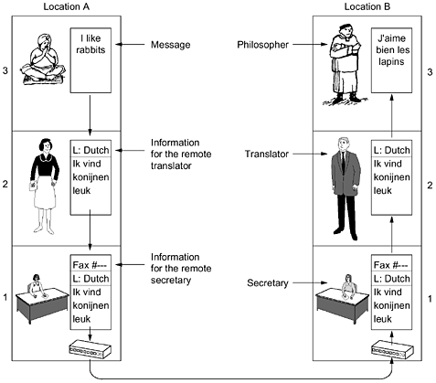
Exemple of layered communication

Slide 6
Protocol Hierarchies
Networks organised as stacks of layers
  Reduce complexity
  Each layer offers services to higher layers
Equivalent to data abstraction
Network architecture = a set of layers and procotols

Slide 7
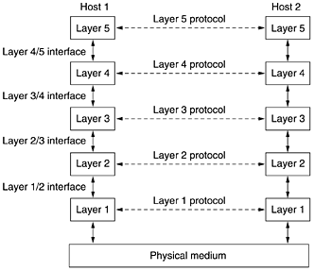
Layers, protocols, interfaces

Slide 8

The OSI Reference Model
All People Seem To Need Data Processing

Slide 9
Principles of the OSI model
A layer should be created where a different abstraction is needed.
Each layer should perform a well-defined function.
The function of each layer should be chosen with an eye toward defining internationally standardized protocols.
The layer boundaries should be chosen to minimize the information flow across the interfaces.
The number of layers should be large enough that distinct functions need not be thrown together in the same layer out of necessity and small enough that the architecture does not become unwieldy.

Slide 10
The Physical Layer
Raw bits over a communication channel
Data representation
  1–how many volts ?; 0 – how many volts ?
1 bit – How many nanoseconds ?
Bidirectional simultaneous transmission?
Electrical, mechanical, timing interfaces

Slide 11
Data Link layer
Turn the raw transmission into an error free communication line
Sets data in frames=thousands of bytes
Traffic regulation (flow control)
Access to the medium in broadcast shared coomunication lines

Slide 12
The Network Layer
Controls the operation of a subnet
How packets are routed from source to destination
Quality of service – congestion control
Fragmentation and inter-network problems

Slide 13
The Transport Layer
Accept data from upper layers and splits it into packets (small units)
Ensure that packets arrive correctly to the other end
Type of service: error free PtoP, preserve order or not, guarantees delivery or not, broadcast
True end-to-end layer

Slide 14
The Session Layer
Allows for establishing sessions
Session
  Dialog control
  Token management
  Synchronization

Slide 15
The Presentation Layer
Syntax and semantics of data
Abstract data definitions/ encoding for information exchange between heterogeneous systems
Standard encoding “on the wire”
Exchange unit – record type

Slide 16
The Application Layer
Protocols needed by users:
  HTTP - www
  FTP – file exchange
  TELNET – remote command
  SSH – remote command
  SMTP – mail exchange

Slide 17
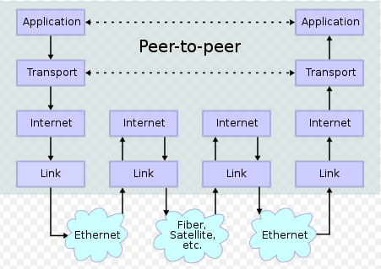
TCP/IP Reference Model

Slide 18
OSI Model vs TCP/IP Model
OSI
TCP/IP
Application
Transport
Internet
Host to Network

Slide 19
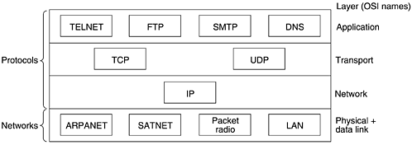
Protocols in the TCP/IP Model

Slide 20
Network Standardization
Europe 1865 – ITU- International Telecommunication Union
  Radiocommunications Sector (ITU-R).
  Telecommunications Standardization Sector (ITU-T).
  Development Sector (ITU-D)
USA – ISO/ANSI – establishing standards
  ISO is a member of ITU-T
USA – NIST (National Institute of Standards and Technology) – issues standards for the US gov. (except DOD)
WorldWide IEEE (Institute of Electrical and Electronics Engineers) – standardization groups.

Slide 21
IEEE Standards
Number | Topic
802.1 | Overview of architecture of LANs
802.2 | Logical link control (hibernating)
802.3 | Ethernet (*)
802.4 | Token ring (hibernating)
…
802.11 | Wireless LANs (*)
802.13 | Nobody wanted it (unlucky number) ☺
802.15 | Personal area networks (Bluetooth)
802.16 | Broadband wireless

Slide 22
ARPANET Standards
1983 – IAB (Internet Architecture Board) – watch over ARPANET – DoD.
Proposals = Request for Comments (RFC) –http://www.ietf.org/rfc
RFC=>standard stages:
  Ideea completely explained in a RFC =>Proposed Standard
  A working implementation => Draft Standard
  Everything OK => RFC=>Internet Standard
There are over 3000 RFCs. (ex:FTP RFC775, RFC959)

Slide 23
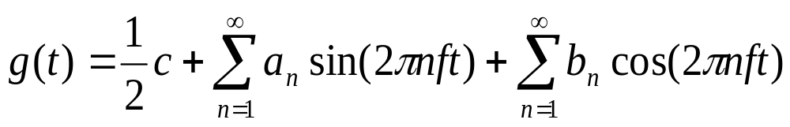
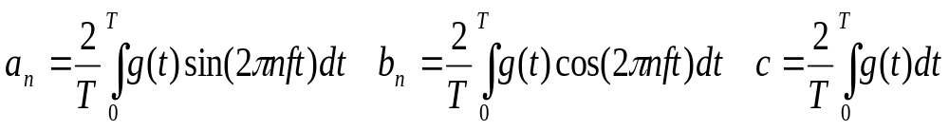
Theoretical Bases for Data Comm
Jean Baptiste Fourier => Fourier decomposition (Fourier Series)
For g(t) periodic of period T. a_{n}, b_{n} amplitutes of the n-th harmonic. f=1/T – fundamental frequency

Slide 24
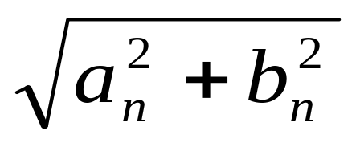
Signal Energy & Loss
Direct proportional with the transmitted signal energy at the corresponding freq
Any signal transmission occurs with power loss.
Fourier coef are not affected proportionally by the power loss => signal amplitude is distorted
Frequencies : 0-F_{max} =>the amplitutdes are undiminished – above they are attenuated.

Slide 25
Medium Bandwidth
The range of frequencies for a given media for which the signal Is not strongly attenuated = BANDWIDTH
Bandwidth – is a physical property of the transmission medium.
Bandwidth = valid frequency spectrum.

Slide 26
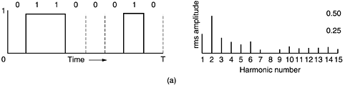
Bandwidth-Limited Signals
Character ‘b’ = 01100010 – to be transmitted
The root mean square coefficients (bellow)

Slide 27
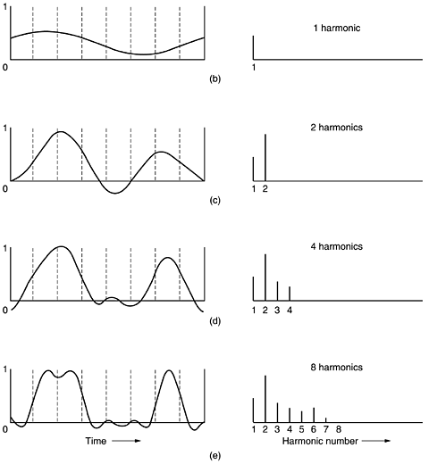

Slide 28
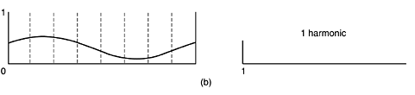
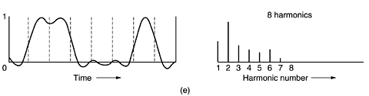

Slide 29
Bandwidth – example
Speed: b bits/sec - 1 bit at a time=>
=>Time required to transfer 8 bits T:= 8/b sec, =>Freq of first harmonic: b/8 Hz.
Ordinary tel line bandwidth: 3000 Hz=3 kHz.
=>Highest harmonic no: 3000/(b/8)=24000/b.

Slide 30
Bandwidth example 3kHz tel line
Bps | T(msec) | 1st harmonic (Hz) | # Harmonics sent
300 | 26.67 | 37.5 | 80
600 | 13.33 | 75 | 40
1200 | 6.67 | 150 | 20
2400 | 3.33 | 300 | 10
4800 | 1.67 | 600 | 5
9600 | 0.83 | 1200 | 2
19200 | 0.42 | 2400 | 1
38400 | 0.21 | 4800 | 0

Slide 31
Bandwidth vs Data Rate
1924 Henri Nyquist –relation between bandwidth and data rate in a noiseless channel (throughput):
Nyquist Theorem:(bandwidth/data rate equiv)
A data signal on a medium with H Hz bandwidth can be reconstructed by making 2H samples/sec. For a signal of V discrete levels:
Maximum data rate=2H log₂V bits/sec.
3 kHz channel (binary signals) => max_data_rate=6000 bps throughput =2*3000 log₂2 = 6000 bps.

Slide 32
Throughput in a noisy channel
S – the signal power; N – the noise power
=> S/N the signal to noise ratio.
Signal to noise (decibels) 1 dB = 10 log₁₀ S/N.
Ex: S/N = 10 => 10 dB; S/N =100 => 20 dB, etc
Shannon’s Theorem (throughput on a noisy channel)
The maximum throughput of a noisy channel of bandwidth H with a signal to noisy ratio of S/N is:
Maximum throughput = H log₂(1+S/N) bps.
Ex: tel line Bandwidth=3kHz; S/N=30 dB =>
Max throughput = 3000 * log₂(1+1000) =~ 30.000 bps = 28.8 kbps

Slide 33
Bottom Line
Nyquist’s theorem means finding a way to encode more bits per cycle improves the data rate
Shannon’s theorem means that no amount of clever engineering can overcome the fundamental physical limits of a real transmission system.

Slide 34
Transmission Media Categories
Guided Transmission Media
Wireless Transmission Media
Communication Satellites
The Public Switched Telephone Line (PSTN)
The Mobile Telephone System
Cable Television

Slide 35
Guided Transmission Media
Magnetic Media
Ultrium tape =100GB. A box 60x60x60 holds 1000 tapes =>200 Tbytes=1600 Tbits.
A box can be delivered in 24H anywhere in USA => throughput: 1600 Tbits/86400 sec = 19 Gbps !!!
CONCLUSION:
Never underestimate the bandwidth of a station wagon full of tapes hurtling down the highway ☺

Slide 36
Guided Media
Twisted Pair/ Unshielded TP (UTP)
- classic telephone lines – 2 wires
  Category 3 (a) – 16MHz
  Category 5 (b) – 100 MHz
  Category 6 – 250 MHz
  Category 7 – 600 MHz
Throughput : a few Mbit/sec - Gbits.

Slide 37
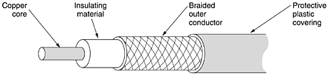
Guided Media
Coaxial Cable
Bandwidth ~ 1 GHz (better shielding)

Slide 38
Guided Media
Fiber Optics
Technology:
  Light source
  Transmission media
  Detector
Problems: refraction (light escaping from the fiber) – Solution – critical angle.
Types:
  Multi-mode fiber
  Single-mode fiber

Slide 39
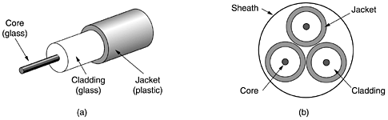
Fiber optics - continued
Lower refraction index

Slide 40
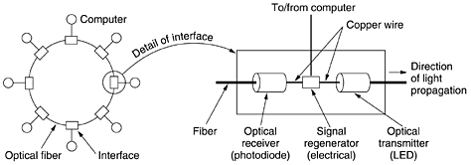
Fiber Optic Equipments
Active repeater

Slide 41
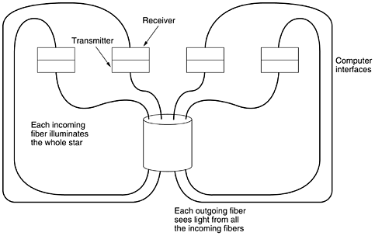
Fiber optics - Equipments
Passive repeater

Slide 42
Wireless Transmission
Uses Electromagnetic pulses to send signals.
Two transmission policies:
  Frequency hopping spread spectrum- FHSS
  Direct sequence spread spectrum – DSSS
FHSS – discovered and introduced by Heddy Lamarr – an austrian born actrice (Czech movie Extase – 1933) .

Slide 43
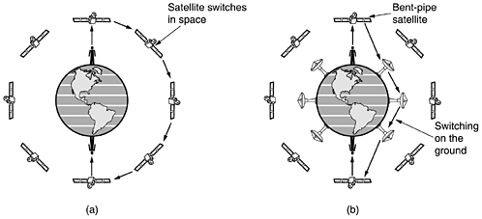
Communication Satellites
More – read chapter 2 – Computer Networks

Slide 44
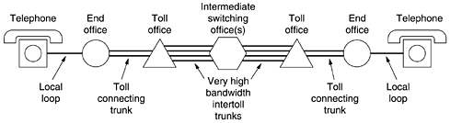
The PSTN system

Slide 45
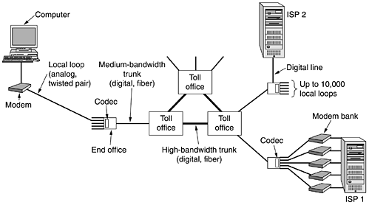
The PSTN System

Slide 46
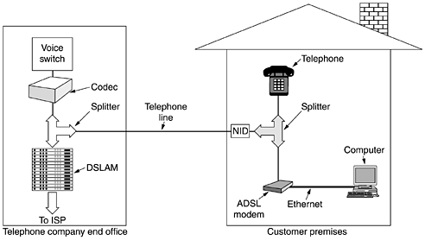
PSTN – Asymmetric DSL

Slide 47
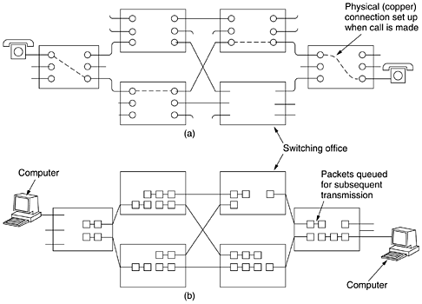
Circuit switching/packet switching

Slide 48
The mobile phone system
Analog voice
Digital voice
Digital voice and Data
Differences between USA and Europe.

Slide 49
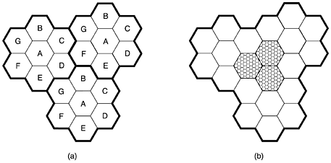
The mobile telephone system
In each cell - MTSO (Mobile Telephone Switching Office)
MTSO-MTSO links – packet switched

Slide 50
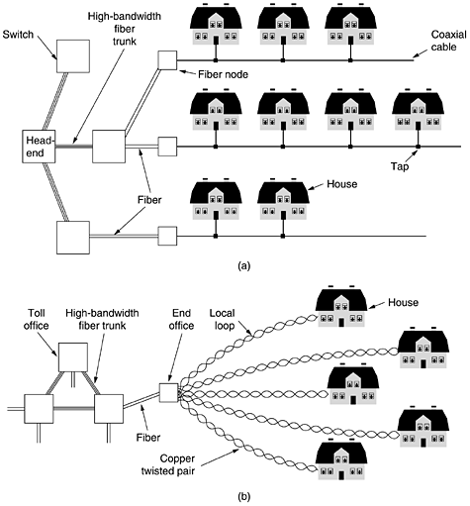
Cable Television Systems
CMTS (Cable Modem Termination System)

Slide 51
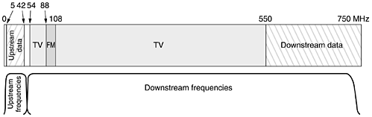
Cable Television for Internet

Slide 52
Material Readings
Chapters: 1 and 2 from Computer Networks (A. Tanenbaum)

